Slide 1

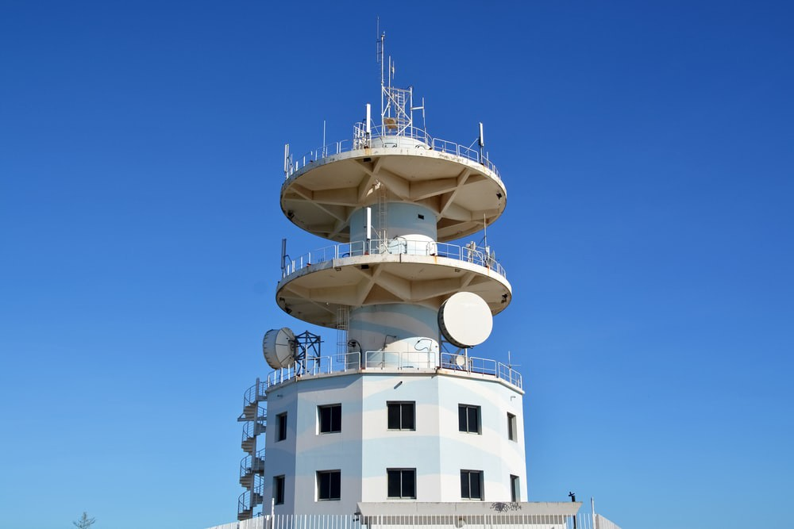
Telecommunication churn Prediction
Presented by:- Group 3
Mentor Name:- Rajshekhar
Date of submission:- 9/Sep/22
Name of participants:
Sonali Sahu
Mr. Mohd Yasir
Mr. Akshay Arvind Ukey
Mr. Sonu Kumar
Mr. Nilesh Ashok Chipade
Mr. Vinayak Subhash Dhage

Slide 2
Business Problem:
Predicting customer churn is critical for telecommunication companies to be able to effectively retain customers. It is more costly to acquire new customers than to retain existing ones. For this reason, large telecommunications corporations are seeking to develop models to predict which customers are more likely to change and take actions accordingly.
Objective:
The objective of the analysis is to predict customers Churning rate, what is the probability that customer would change the service provider in near future and to understand important factors associated with them
We build a model to predict how likely a customer will churn by analyzing its characteristics. The objective is to obtain a data-driven solution that will allow us to reduce churn rates and, as a consequence, to increase customer satisfaction and corporation revenue.

Slide 3
Project Architecture / Project Flow
Our project consists of the following sections:
Data Reading
Exploratory Data Analysis
Data Cleaning
Data Visualization
Normalization/Standardization
Feature Engineering
Splitting the data in training and testing sets
Assessing multiple algorithms
Algorithm selected: Gradient Boosting
Hyperparameter tuning
Performance of the model
Drawing conclusions — Summary
Deployment

Slide 4
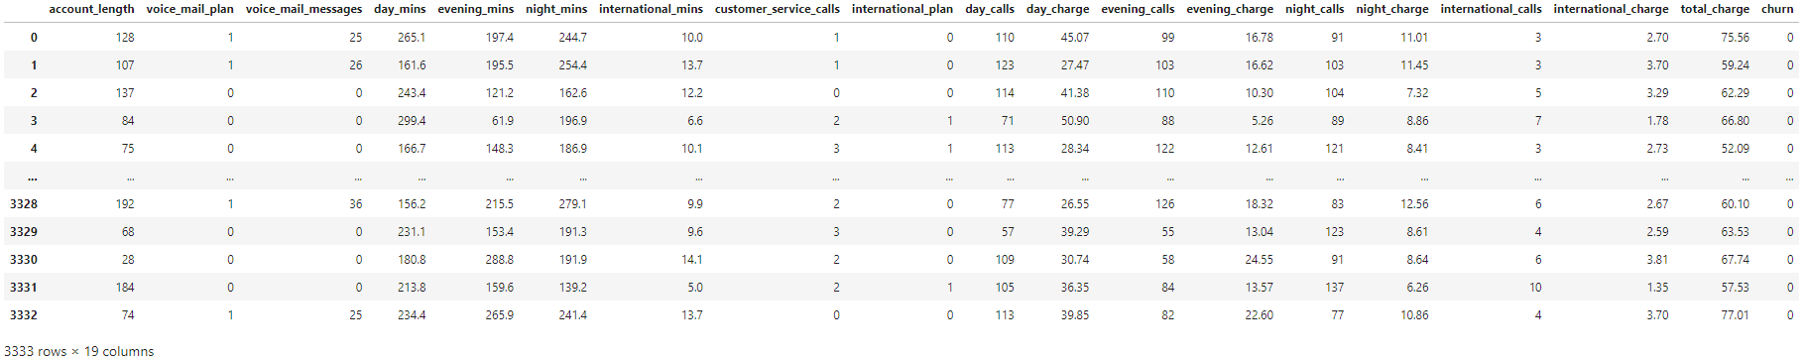
1. Data Reading
The data set used in this project is sent from ExcelR Solutions and contains nineteen columns (independent variables) that indicate the characteristics of the clients of a fictional telecommunications corporation. The Churn column (response variable) indicates whether the customer departed within the last month or not. The class 'No' includes the clients that did not leave the company last month, while the class 'Yes' contains the clients that decided to terminate their relations with the company. The objective of the analysis is to obtain the relation between the customer’s characteristics and the churn.

Slide 5
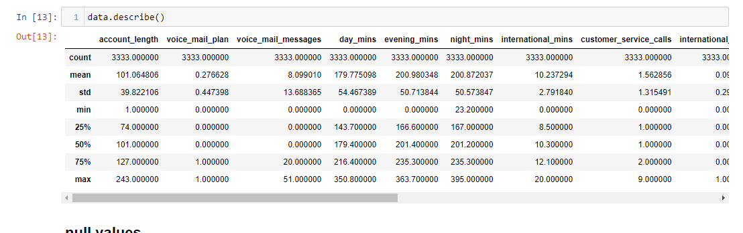
2. Exploratory Data Analysis (EDA)
Exploratory data analysis consists of analyzing the main characteristics of a data set usually by means of visualization methods and summary statistics. The objective is to understand the data, discover patterns and anomalies, and check assumptions before performing further evaluations.

Slide 6
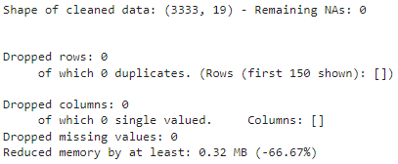
3.Data Cleaning
At the beginning of EDA, we want to know as much information as possible about the data, this is when the pandas.DataFrame.info method comes in handy. This method prints a concise summary of the data frame, including the column names and their data types, the number of non-null values, and the amount of memory used by the data frame.
The data set contains 3333 observations and 19 columns. Apparently, there are no null values on the data set.

Slide 7
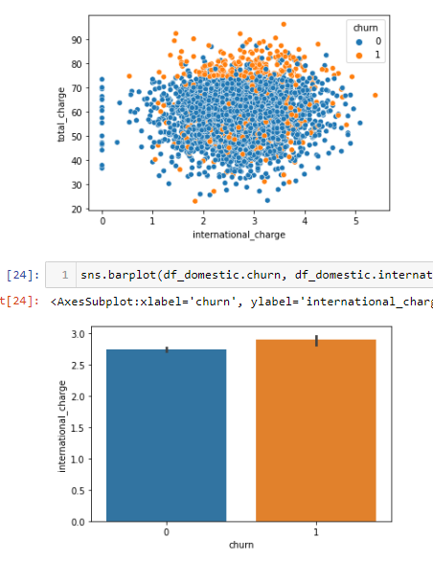
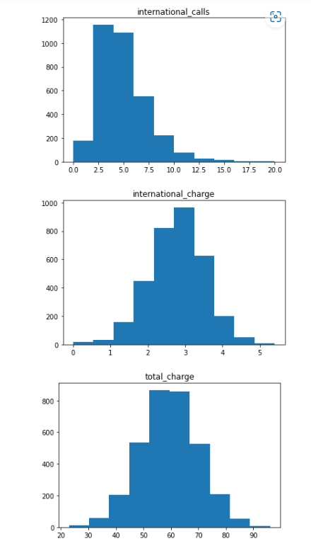
4. Data Visualization
We are going to use normalized stacked bar plots to analyze the influence of each independent categorical variable in the outcome.
A normalized stacked bar plot makes each column the same height, so it is not useful for comparing total numbers; however, it is perfect for comparing how the response variable varies across all groups of an independent variable.
On the other hand, we use histograms to evaluate the influence of each independent numeric variable in the outcome. As mentioned before, the data set is imbalanced; therefore, we need to draw a probability density function of each class (density=True) to be able to compare both distributions properly.

Slide 8
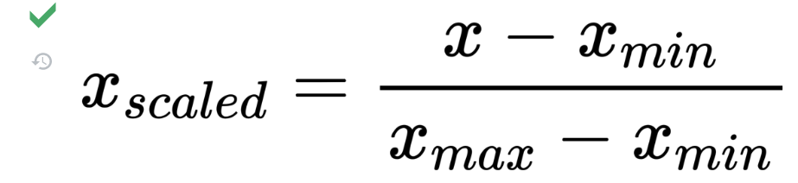
5. Normalization/Standardization
Data Normalization is a common practice in machine learning which consists of transforming numeric columns to a common scale. In machine learning, some feature values differ from others multiple times. The features with higher values will dominate the learning process; however, it does not mean those variables are more important to predict the target. Data normalization transforms multiscale data to the same scale. After normalization, all variables have a similar influence on the model, improving the stability and performance of the learning algorithm.
There are multiple normalization techniques in statistics. In this project, we will use the min-max method to rescale the numeric columns to a common scale.
The min-max approach (often called normalization) rescales the feature to a fixed range of [0,1] by subtracting the minimum value of the feature and then dividing by the range.

Slide 9
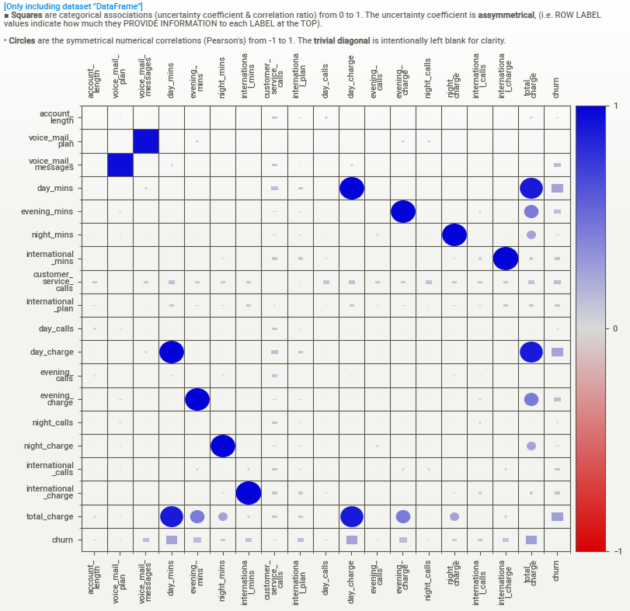
6. Feature Engineering
Mutual information(analysis of linear and nonlinear relationships) measures the mutual dependency between two variables based on entropy estimations. In machine learning, we are interested in evaluating the degree of dependency between each independent variable and the response variable. Higher values of mutual information show a higher degree of dependency which indicates that the independent variable will be useful for predicting the target.
The Scikit-Learn library has implemented mutual information in the metrics package. The following code computes the mutual information score between each categorical variable of the data set and the Churn variable.
Mutual information allows us not only to better understand our data but also to identify the predictor variables that are completely independent of the target. The mutual information score really close to 0, meaning those variables do not have a strong relationship with the target. we should consider removing those variables from the data set before training as they do not provide useful information for predicting the outcome.
The mutual information extends the notion of correlation to nonlinear relationships since, unlike Pearson’s correlation coefficient, this method is able to detect not only linear relationships but also nonlinear ones.

Slide 10
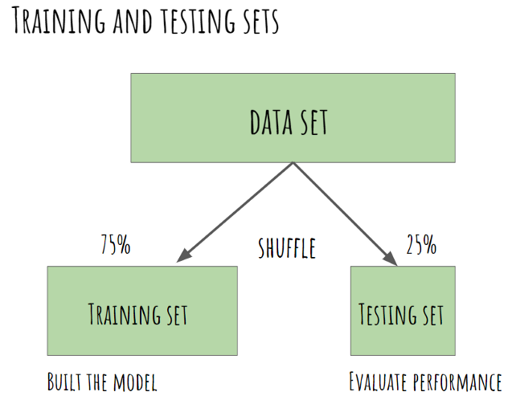
7. Splitting the data in training and testing sets
The first step when building a model is to split the data into two groups, which are typically referred to as training and testing sets. The training set is used by the machine learning algorithm to build the model. The test set contains samples that are not part of the learning process and is used to evaluate the model’s performance. It is important to assess the quality of the model using unseen data to guarantee an objective evaluation.

Slide 11
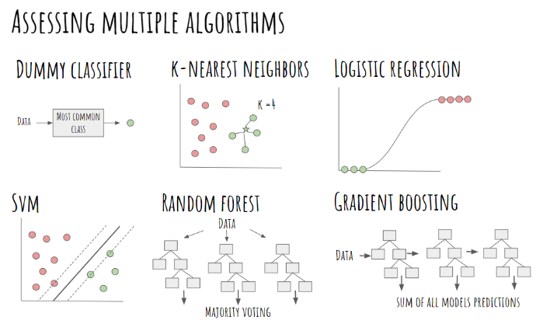
8. Assessing multiple algorithms
Algorithm selection is a key challenge in any machine learning project since there is not an algorithm that is the best across all projects. Generally, we need to evaluate a set of potential candidates and select for further evaluation those that provide better performance.
In this project, we compare 6 different algorithms, all of them already implemented in Scikit-Learn
Below are the Models we created and their accuracy:
1. Logistic Regression: 75.92%
2. Random Forest: 91.15%
3. Support Vector Machine: 98.73%
4. XG Boost: 99.67%
5. Gradient Boosting-99.7%

Slide 12
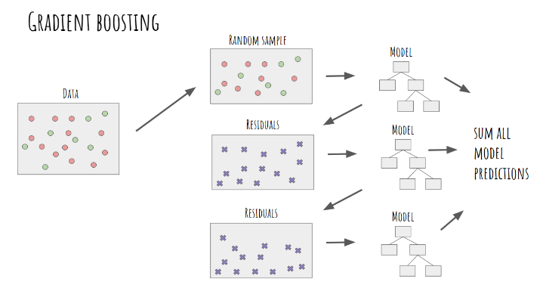
9. Algorithm selected: Gradient Boosting
Gradient Boosting is a very popular machine learning ensemble method based on a sequential training of multiple models to make predictions. In Gradient Boosting, first, we’ll make a model using a random sample of your original data. After fitting the model, we can make predictions and compute the residuals of the model. The residuals are the difference between the actual values and the predictions of the model. Then, we’ll train a new tree based on the residuals of the previous tree, calculating again the residuals of this new model. We repeat this process until we reach a threshold (residual close to 0), meaning there is a very low difference between the actual and predicted values. Finally, we can take a sum of all model forecasts (prediction of the data and predictions of the error) to make a final prediction.

Slide 13
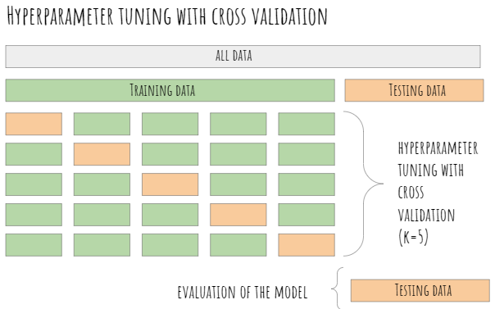
10.Hyperparameter tuning
We’ll split our data into a training set for learning the parameters of the model, and a testing set for evaluating its performance. The next step in the machine learning process is to perform hyperparameter tuning. The selection of hyperparameters consists of testing the performance of the model against different combinations of hyperparameters, selecting those that perform best according to a chosen metric and a validation method.
For hyperparameter tuning, we need to split our training data again into a set for training and a set for testing the hyperparameters (often called validation set). It is a very common practice to use k-fold cross-validation for hyperparameter tuning. The training set is divided again into k equal-sized samples, 1 sample is used for testing and the remaining k-1 samples are used for training the model, repeating the process k times. Then, the k evaluation metrics (in this case the accuracy) are averaged to produce a single estimator.
It is important to stress that the validation set is used for hyperparameter selection and not for evaluating the final performance of our model.

Slide 14
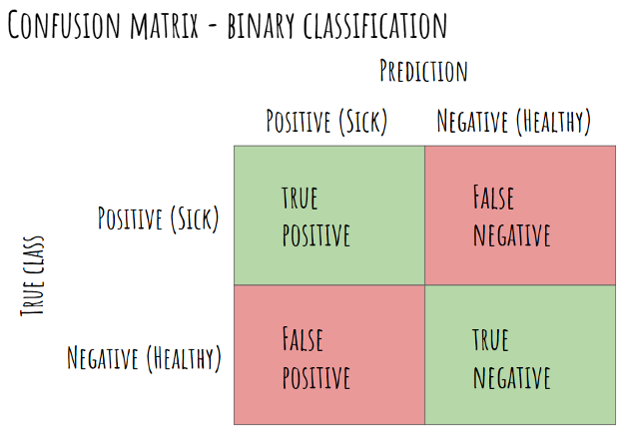
11.Performance of the model
The last step of the machine learning process is to check the performance of the model (best hyperparameters ) by using the confusion matrix and some evaluation metrics.
The confusion matrix, also known as the error matrix, is used to evaluate the performance of a machine learning model by examining the number of observations that are correctly and incorrectly classified. Each column of the matrix contains the predicted classes while each row represents the actual classes or vice versa. In a perfect classification, the confusion matrix will be all zeros except for the diagonal. All the elements out of the main diagonal represent misclassifications. It is important to bear in mind that the confusion matrix allows us to observe patterns of misclassification (which classes and to which extend they were incorrectly classified).

Slide 15
12. Drawing conclusions — Summary
we have walked through a complete end-to-end machine learning project using the Telecommunication customer Churn dataset. We started by cleaning the data and analyzing it with visualization. Then, to be able to build a machine learning model, we transformed the categorical data into numeric variables (feature engineering). After transforming the data, we tried 6 different machine learning algorithms using default parameters. Finally, we tuned the hyperparameters of the Gradient Boosting Classifier (best performance model) for model optimization, obtaining an accuracy of nearly 80% (close to 6% higher than the baseline).
It is important to stress that the exact steps of a machine learning task vary by project. Although in the project we followed a linear process, machine learning projects tend to be iterative rather than linear processes, where previous steps are often revisited as we learn more about the problem we try to solve.
Model Accuracy-
Precision-
Recall-
F1 score-

Slide 16
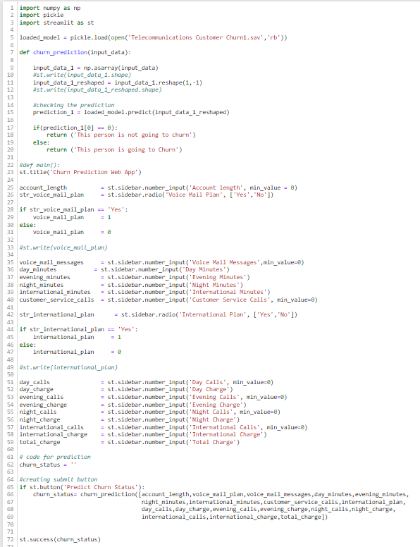
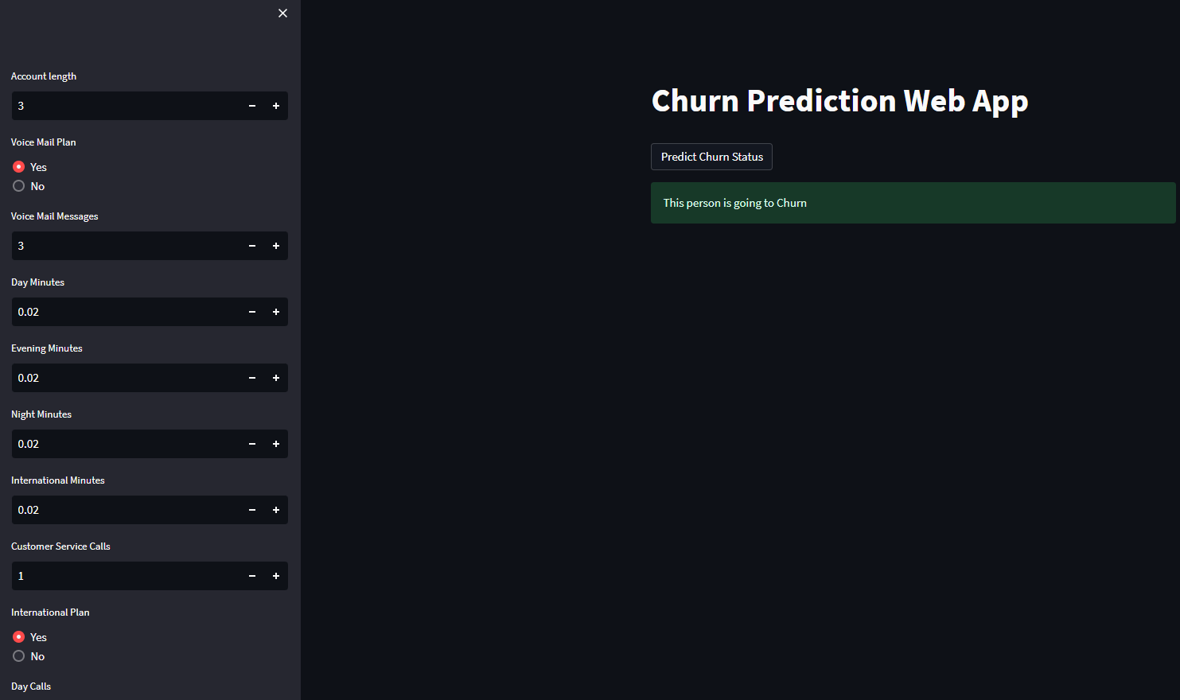
13. Deployment
Software deployment is all of the activities that make a software system available for use. The general deployment process consists of several interrelated activities with possible transitions between them. These activities can occur on the producer side or on the consumer side or both. Below is our Web Page ready for deployment. We used streamlit to deploy our model.
.

Slide 17
Challenges faced?
We were not sure of which features to choose to predict the churn rate
We really struggled on deployment part as web page was giving error.
How did you overcome?
1.Ans- We tried feature engineering and build serval models to predict the accuracy and got to know that every feature is crucial while predicting the Churn rate
2.Ans- We did some research on online platform and find our the remedies for our codes.

Slide 18
Thank you

